Slide 1
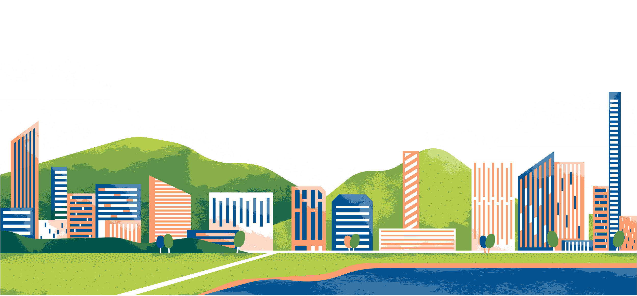
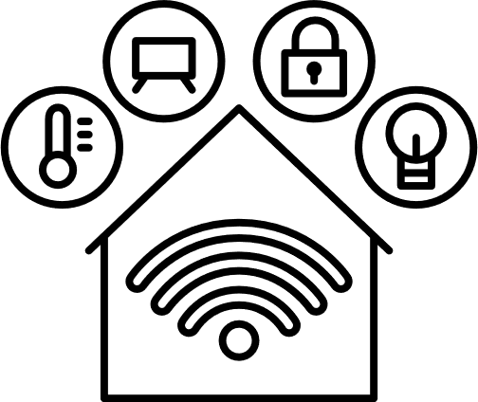
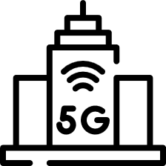

IOT IN
Smart Cities
Smart traffic control
Reem Al Zouhby 2223
Mariam Marhaba 2119
Sourour Hammoud 2254

Slide 2

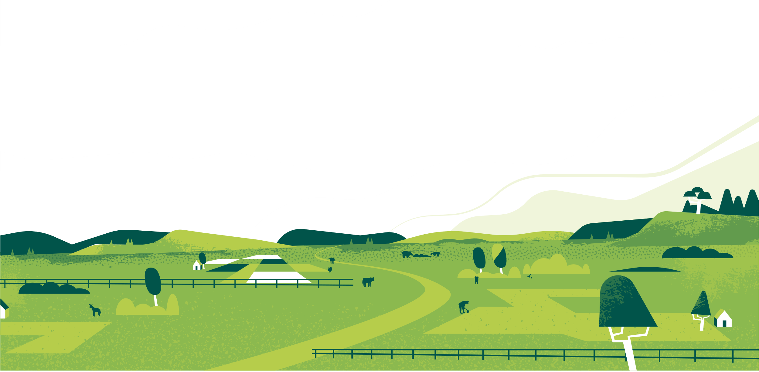

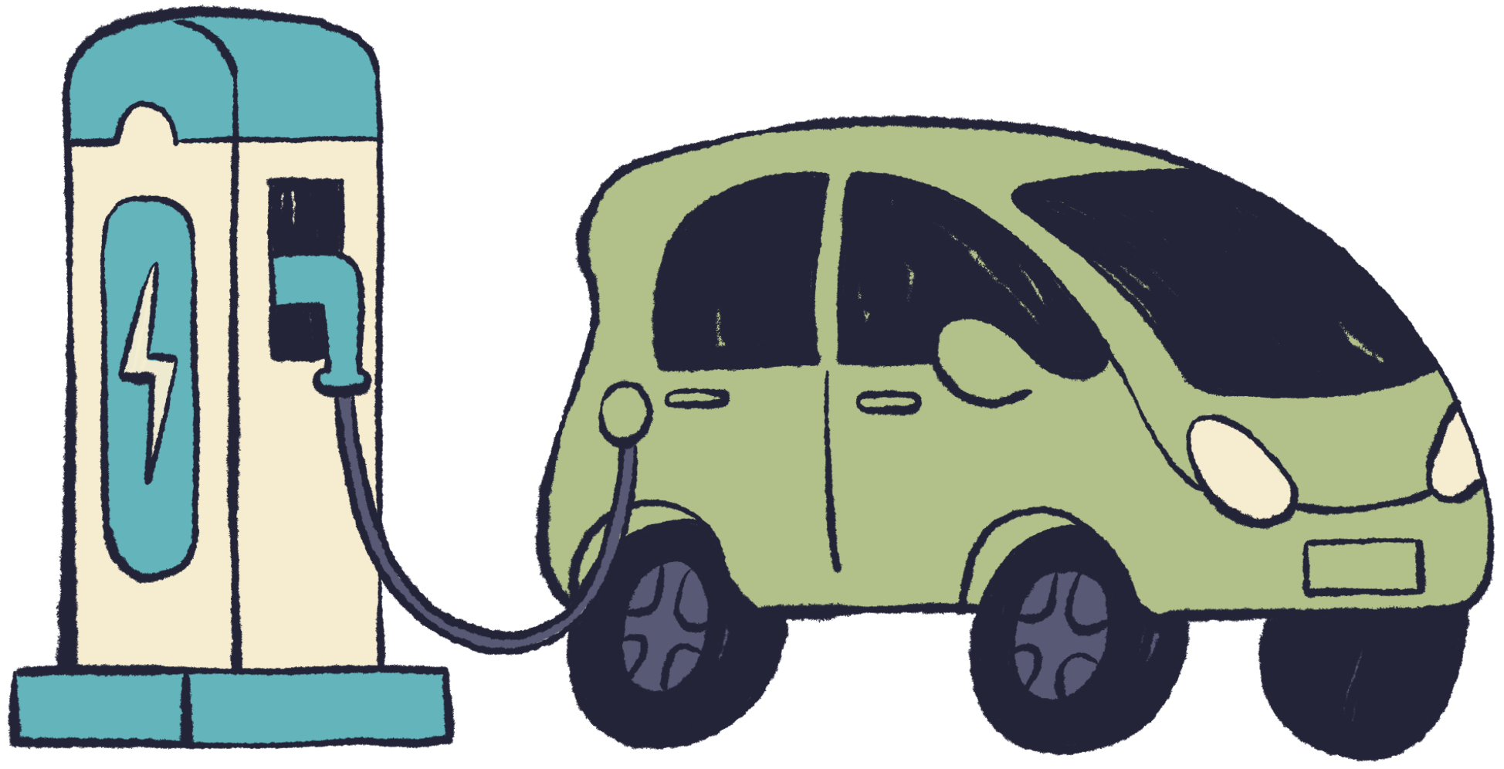
Plan
Introduction
Challenges
Traditional traffic control Problems
Architecture
perception Layer
Network Layer
Processing Layer
Application Layer
Case Study
Expected Results
2

Slide 3
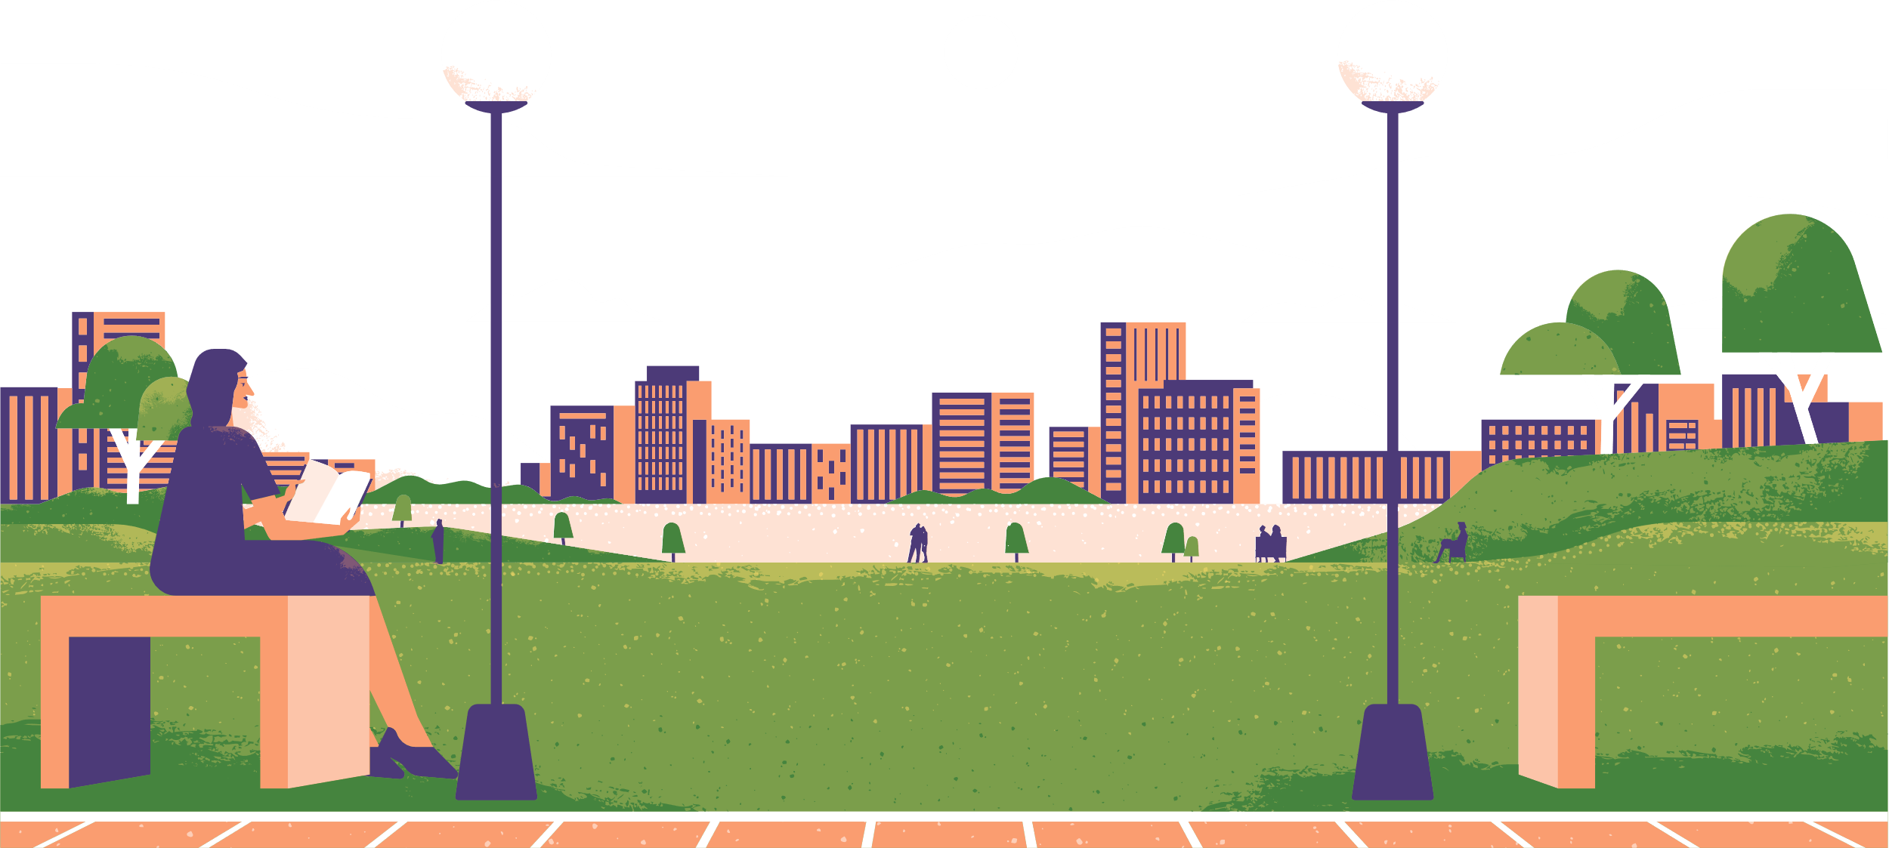
Introduction
Growing cities face serious traffic problems. IoT technology offers a smart solution by using sensors and real-time data to improve traffic flow and make roads safer.
3

Slide 4
Smart Cities and Smart Grid
Smart cities impact smart grids by increasing the need for intelligent and flexible energy management. The growth of IoT systems, electric vehicles, and smart infrastructure forces smart grids to handle higher demand, integrate renewable energy, and improve reliability. This drives smarter, more efficient, and adaptive power systems.
•
4

Slide 5
challenges
Congestion
Delays
Air pollution
Inefficient use of infrastructure
5

Slide 6
Traditional traffic
control Problems:
Static timing plans
Manual monitoring
They cannot handle the dynamic nature of modern traffic
6

Slide 7
Perception layer
Network Layer
Responsible for data collection using
hardware components
Facilitates communication between
devices and central servers
Architecture
Processing Layer
Application Layer
The layer that analyzes and processes
the data collected by sensors
to make decisions.
The layer that delivers services
to users by using the processed data
7

Slide 8

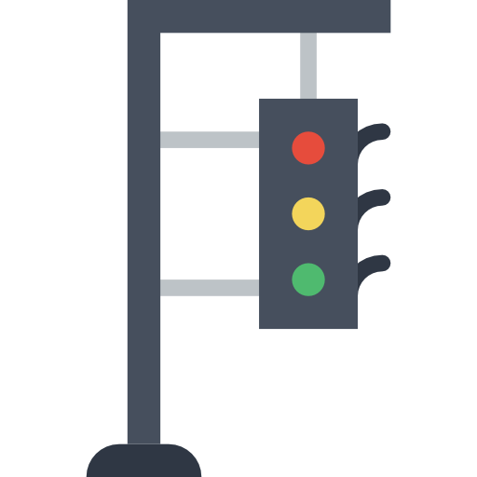

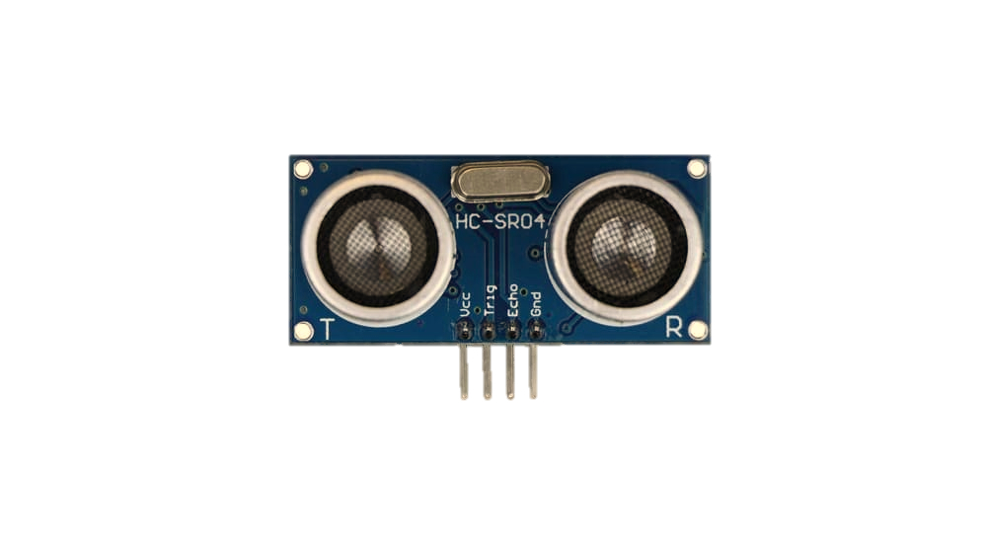
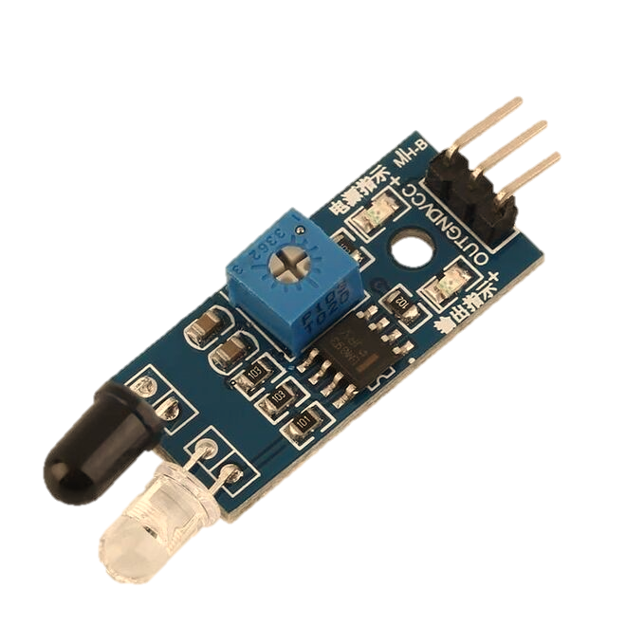

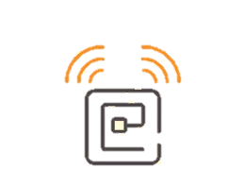
cloud
Wi-Fi - MQTT
Gateway module
ZigBee

Slide 9
Perception layer
Infrared (IR) Sensors
Ultrasonic Sensor
A sensor that uses infrared light
To Detect if a vehicle is present.
A sensor that uses sound waves to
measure distance and detect vehicles.
RFID Tag
A small electronic tag that lets the
System identify emergency vehicles
automatically.
9

Slide 10


Gateway Module
to collect and transmit data from
sensors to the cloud.
Network layer
ZIGBEE
WIFI
Short range communication
Large range communication
10

Slide 11
Communication Protocols
Sensor-to-Gateway (Short-Range)
Gateway-to-Cloud (Long-Range)
ZigBee: Low-power, low-data mesh network. Ideal for connecting many sensors in a small area.
Wi-Fi / 5G / 4G: High-bandwidth, fast data transfer for sending large packets (like video) or aggregated data.
WiFi: Long-range, high power. Good for sensors spread across a wider area.
.
Bluetooth (BLE): Very short-range, for direct local communication.
11

Slide 12
ZigBee is a low-power, low-cost wireless communication protocol used in IoT for short-range data transfer.
Key Features
Range: ~10–100 meters (depending on environment)
Frequency: 2.4 GHz ISM band
Topology: Supports mesh networks, meaning devices can relay data to each other
Data Rate: Up to 250 kbps
Power Consumption: Very low → ideal for battery-powered sensors
ZigBee
12

Slide 13

Processing
Layer
Key Features:
Manages data processing and system control, including:
Control algorithms that dynamically adjust traffic signal durations based on real-time inputs.
Cloud platform (e.g., AWS IoT, Thing Speak, or Google Firebase) for real-time data analytics and visualization.
13

Slide 14
Application
Layer
Key Features:
The layer that displays traffic information to drivers through apps or digital signs.
The layer that provides real-time alerts about congestion or accidents.
The layer that allows users to monitor traffic remotely via dashboards.
The layer that visualizes analyzed data for city traffic management.
14

Slide 15
Why Choose MQTT for Smart Traffic?
Key Features:
Lightweight : ideal for sensors with low power
Publish/Subscribe: easy to scale the system
Works even with unstable networks (weak Wifi)
3 QOS Levels
Very low bandwidth
Security support( TLS encryption)
Easy to integrate with Cloud Platforms( AWS Iot core , Google Cloud)
15

Slide 16
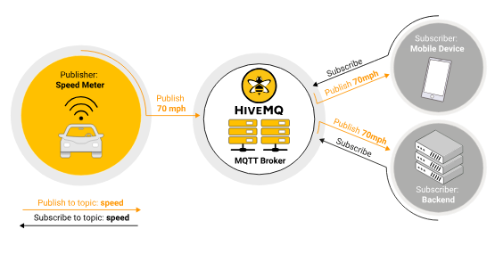
Protocol Spotlight: MQTT
Key Features:
[2]
16

Slide 17
Publisher (Sensors)
Device that sends data to MQTT Broker
In smart traffic , the publishers are the sensors :
Key Features:
Ultrasonic
IR
RFID
traffic/road1/sensor1
17

Slide 18
Broker: HiveMQ
Key Features:
Why HiveMQ???
Reliable & Scalable Supports MQTT 3.1 , 3.11 and 5
Secure : TLS encryption
Easy integration
What’s Broker???
Receives messages from publishers
Stores and manages topics
Send messages to subscribers
Ensures reliability using QOS
Handle connections
18

Slide 19
Subscriber (Actuators)
traffic/road1/sensor1
Key Features:
I want to receive data from sensor 1 on road 1
What’s a Subscriber????
A device or software that receives messages from the MQTT broker
Subscribers are the controllers or actuators ( Traffic light )
They receive data from sensors via HiveMQ to take action
( Change light timing based on vehicle count)
19

Slide 20
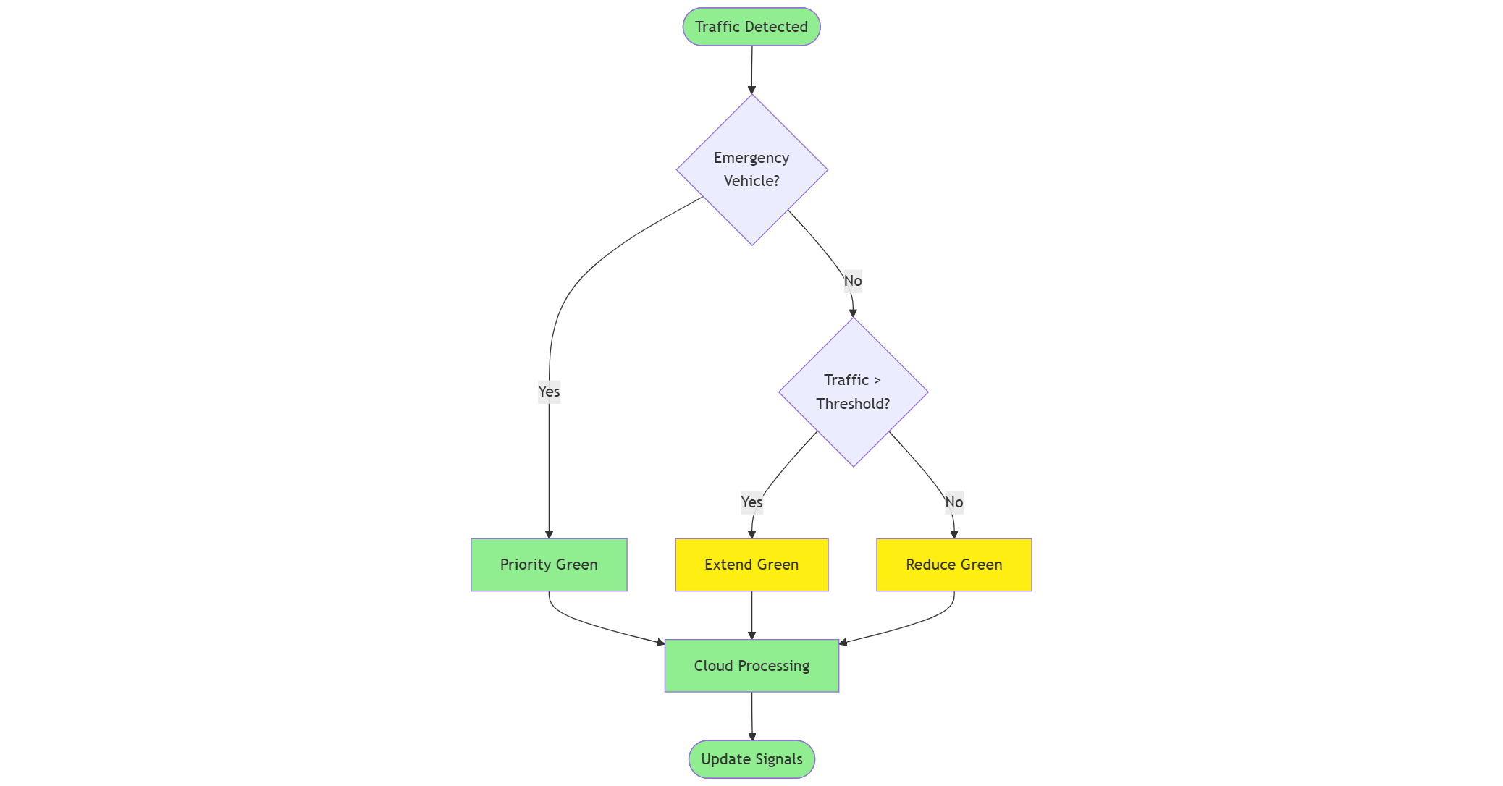
Case Study
Data Collection and Processing:
The system continuously collects data on:
Traffic density (vehicles per minute)
Vehicle type detection (via RFID for emergency vehicles)
Lane-wise congestion levels
This data is transmitted to the cloud where it is:
Stored and analyzed in real-time
Used to determine optimal green light durations for each direction
Logged for historical analysis and model improvement
Pillars:
20

Slide 21
Expected results
Reduced Average Waiting Time
Dynamic Lane Prioritization
Emergency Vehicle Priority
Energy and Resource
Optimization
21

Slide 22
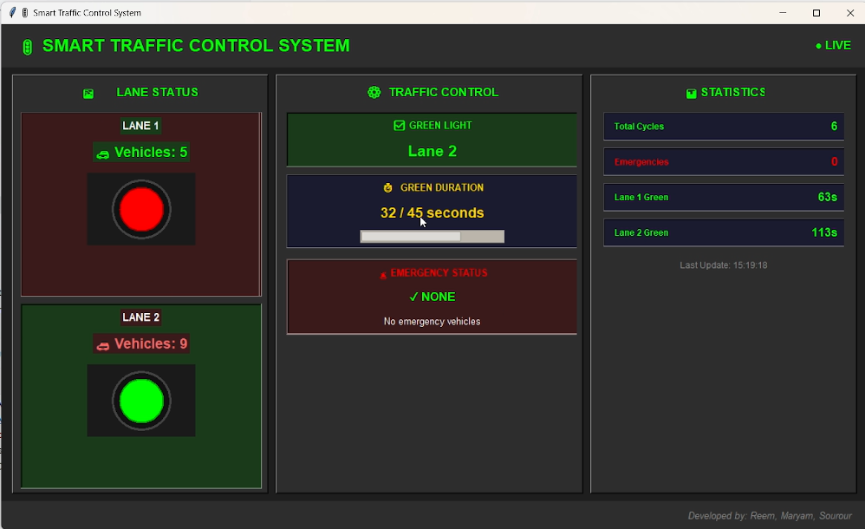
Simulation
10

Slide 23
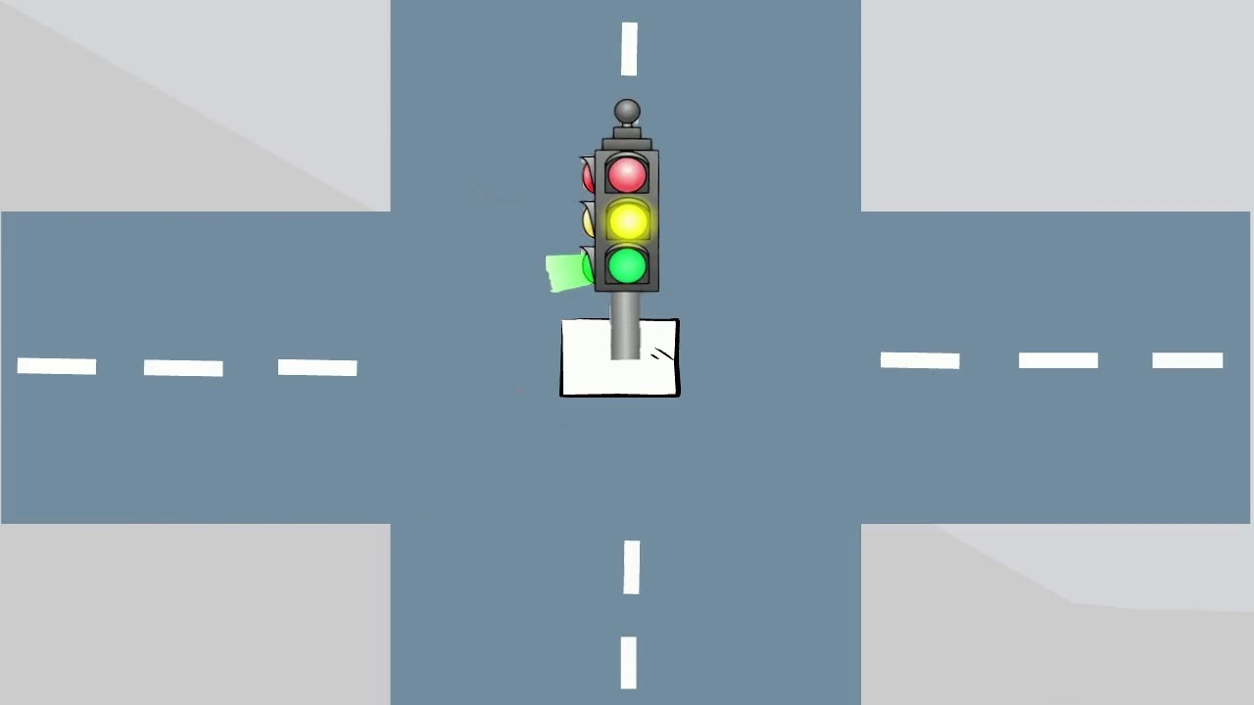


Lane 2
Lane 1
Lane 1
Lane 2

Slide 24

Lane 2
Lane 1
Lane 1
Lane 2

Slide 25

Lane 2
Lane 1
Lane 1
Lane 2

Slide 26
Reference:
https://www.rishabhsoft.com/blog/smart-traffic-control-using-iot [1]
https://www.hivemq.com/sb-assets/f/243938/284x150/2a67a28f71/mqtt-publish-subscribe.svg [2]
26

Slide 27
Thank You So Much!
Designing the Future of Urban Living

